Slide 1

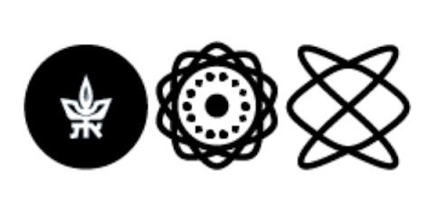
Machine Learning the Entropy to Estimate Free Energy Differences without Sampling Transitions
Yohai Bar-Sinai
Tel-Aviv University Hebrew University
ICS 2026

Slide 2
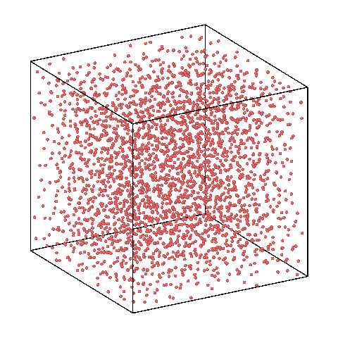
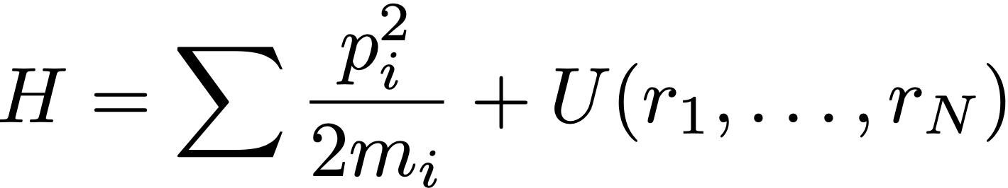
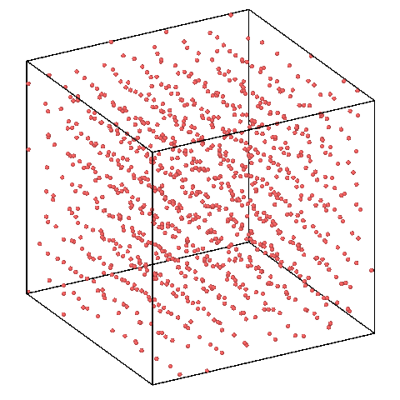

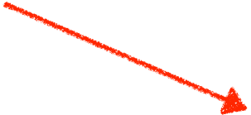
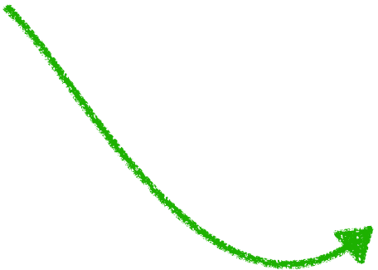
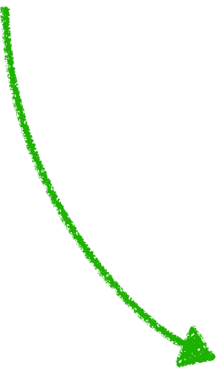
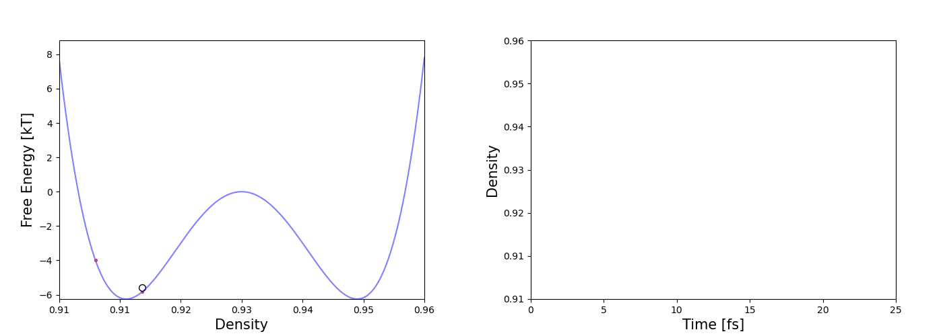
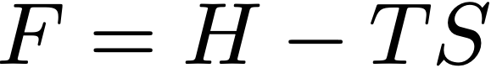
Metastable states pose a computational challenge
?
?
Liquid
Solid
Average energy of a micro state (easy to compute)
To see which is more stable, can we just run an MD simulation and see if the system crystalizes?
How many micro states are there (famously impossible to compute)
Liquid
Solid

Slide 3

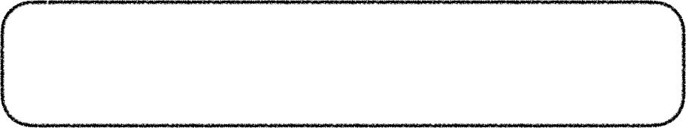

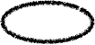
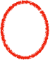
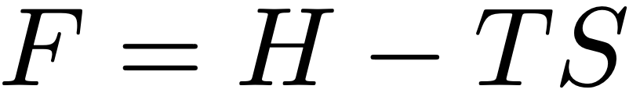
Metastable states pose a computational challenge
Trapping in local free energy minima
Ways out:
Umbrella smapling
Metadynamics
Gaussian accelerated molecular dynamics
On-the-fly enhanced sampling
Liquid
Solid
Key ingredient: induce transitions between metastable states to increase distribution overlap
Challenges
Computationally costly
Requires knowledge of a good collective variable
Boltzmann weight
Liquid
Solid
The difficult bit
But what if we could calculate the free energy directly?

Slide 4
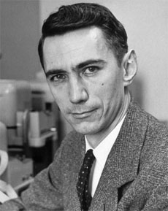
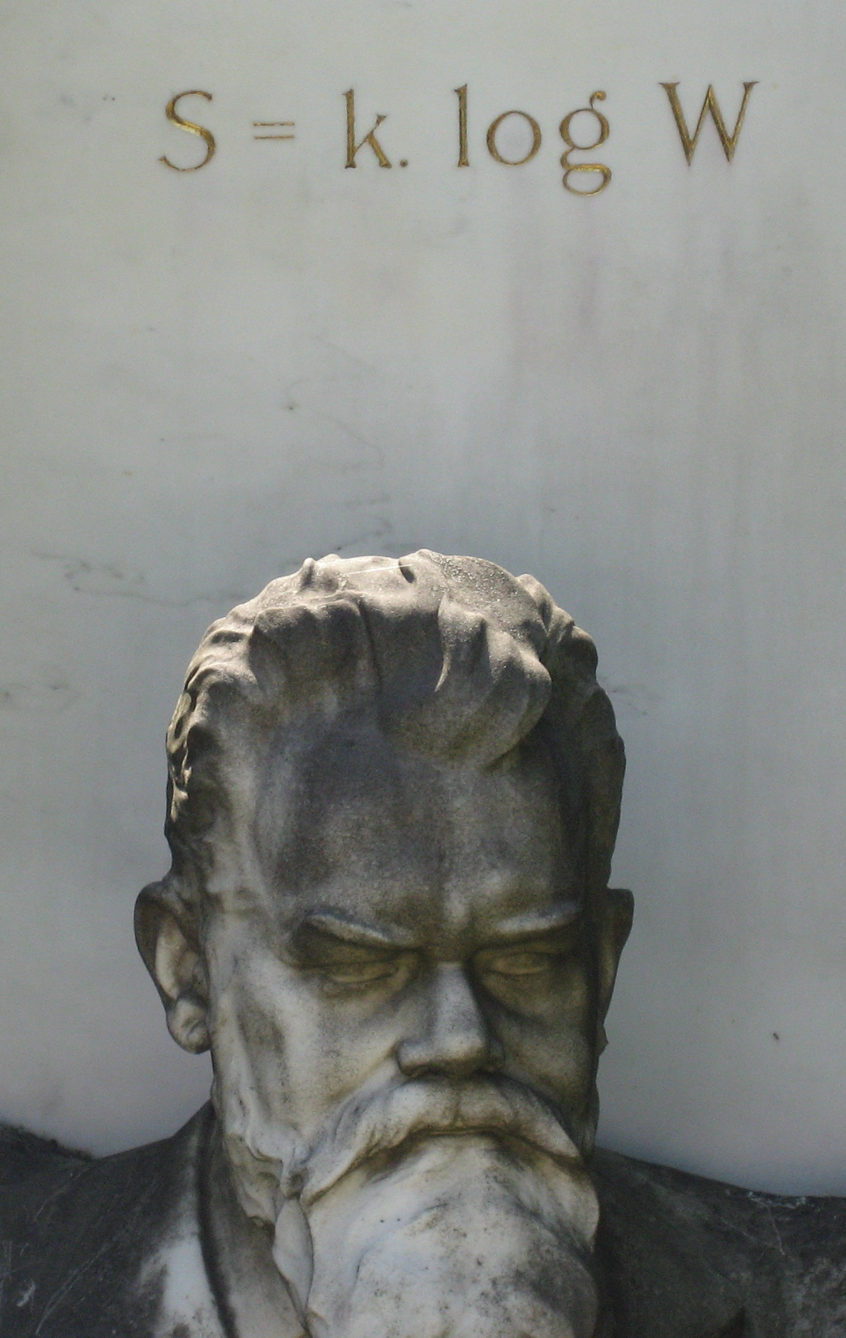
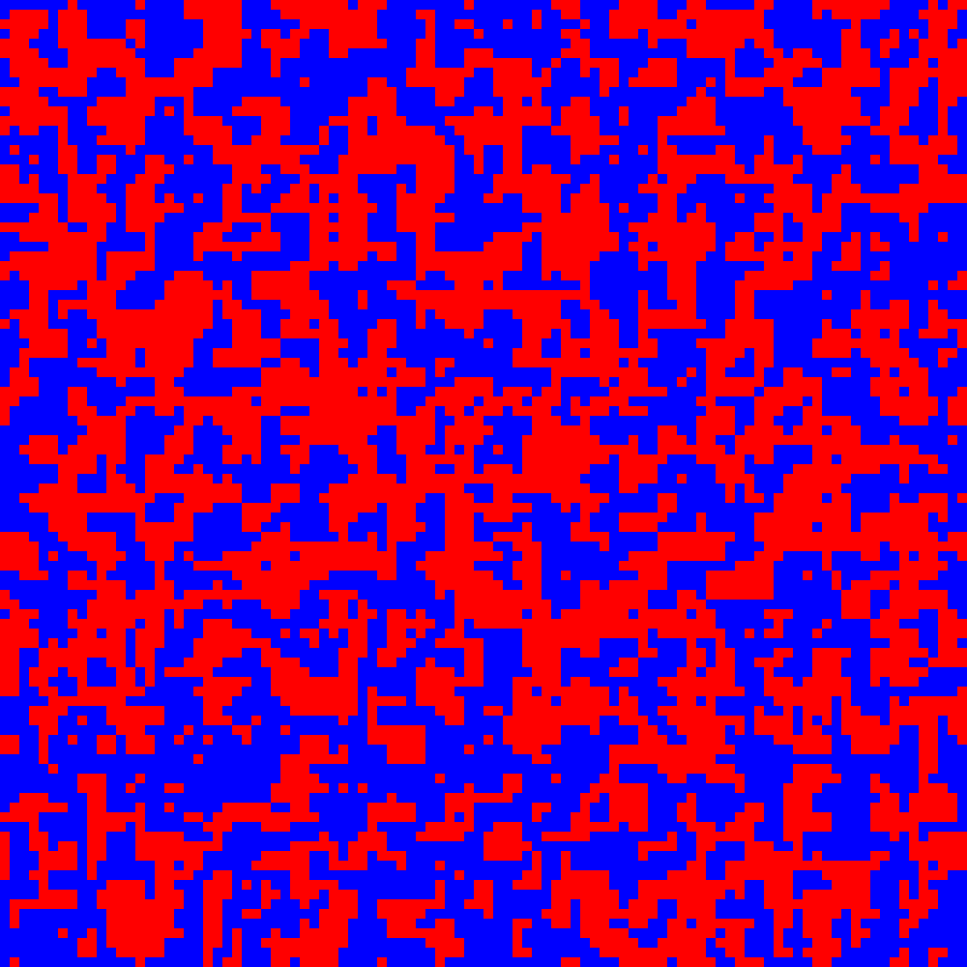

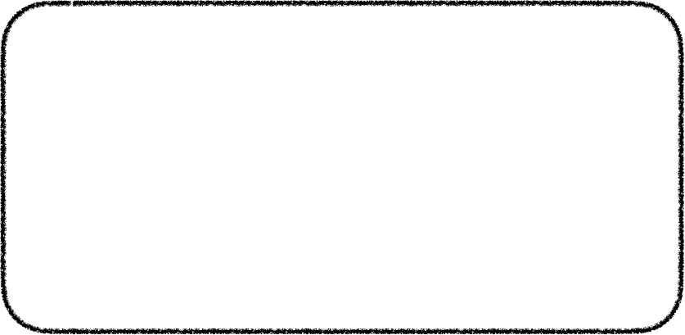
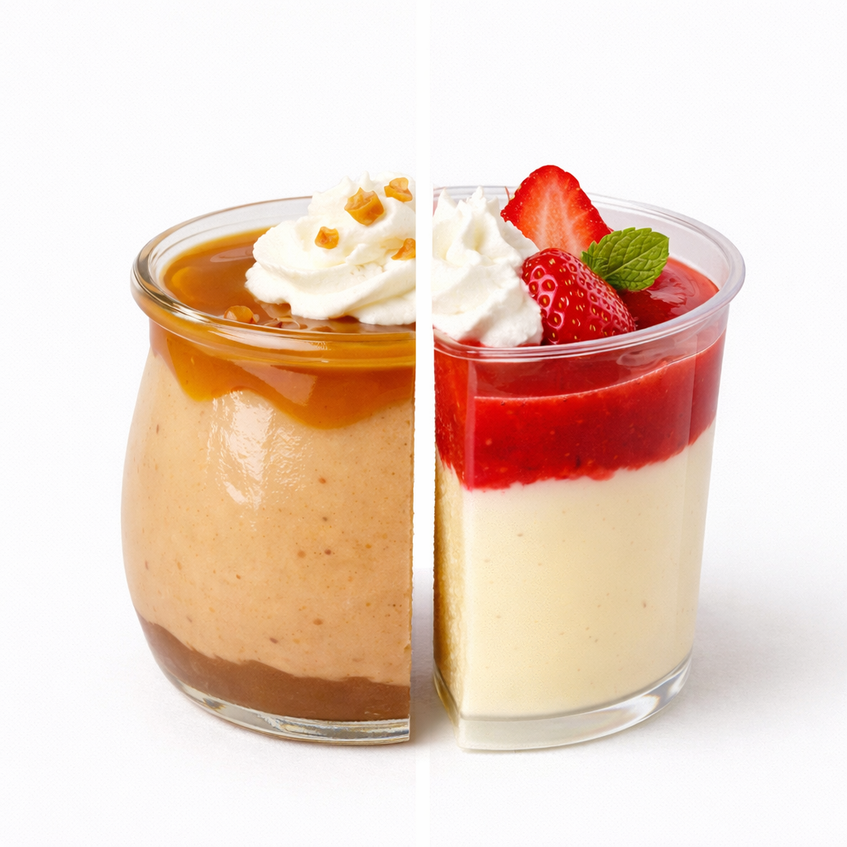
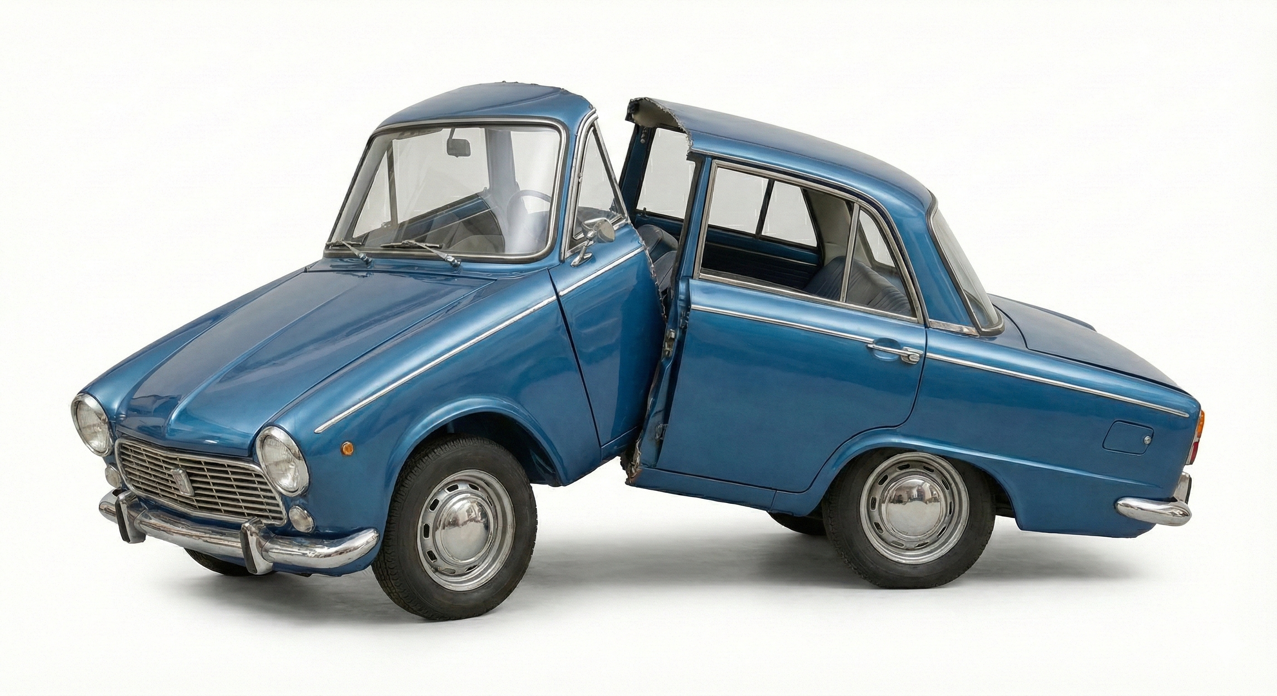
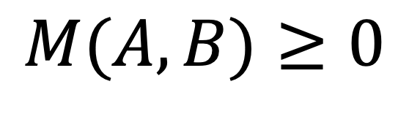
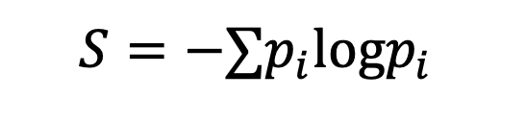
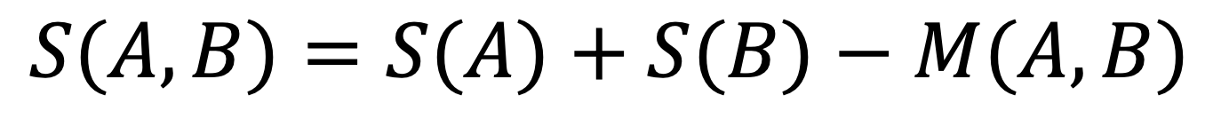
What is entropy?
Entropy is sub-extensive
(Boltzmann)
A
B
$$S=−∑p_{i}logp_{i}$$
(Shannon)
A measure of complexity
What is a complex thing?
Pudding is simple in the sense that it is homogeneous. A car is heterogeneous.
Two times half a car does not make a car.
Richard Dawkins
The blind watchmaker
$$S(A,B)=S(A)+S(B)−M(A,B)$$
$$M(A,B)≥0$$
Mutual information

Slide 5







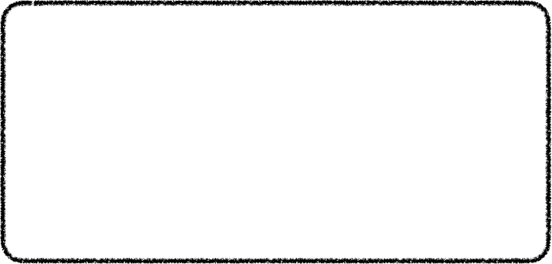


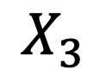
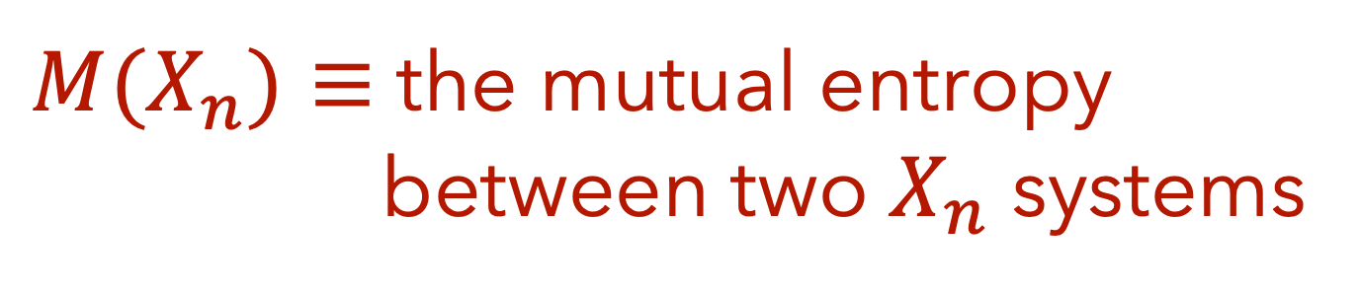
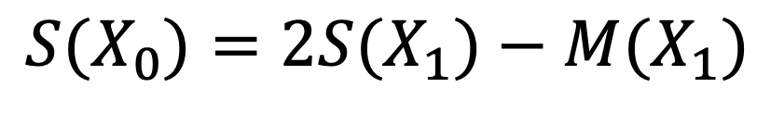
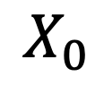
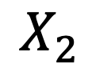
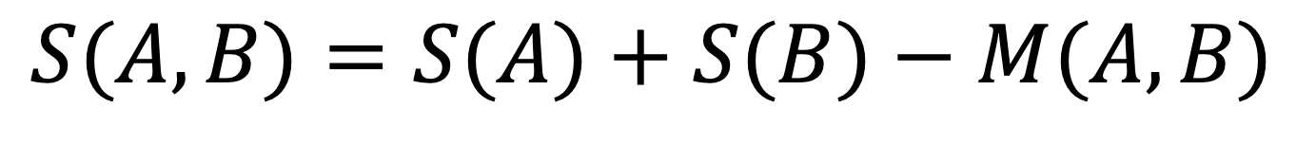
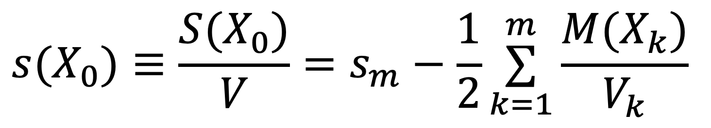
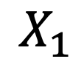
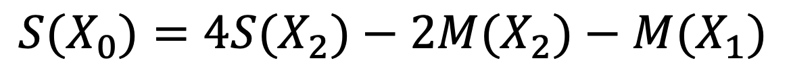
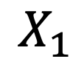
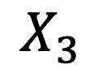
Iterative Calculation of Entropy
$M(X_{n})≡$ the mutual entropy
between two $X_{n}$ systems
$$S(A,B)=S(A)+S(B)−M(A,B)$$
$$S(X_{0})=2S(X_{1})−M(X_{1})$$
$$X_{0}$$
$$S(X_{0})=4S(X_{2})−2M(X_{2})−M(X_{1})$$
$$X_{1}$$
$$X_{1}$$
$$S(X_{0})=8S(X_{3})−4M(X_{3})−2M(X_{2})−M(X_{1})$$
$$X_{2}$$
Specific entropy of the smallest subsystem
Basic idea:
$$X_{3}$$
$$X_{2}$$
$$X_{3}$$
$$s(X_{0})≡\frac{S(X_{0})}{V}=s_{m}−\frac{1}{2}\overset{m}{\underset{k=1}{∑}}\frac{M(X_{k})}{V_{k}}$$
OK, but how do we get the mutual information?
Statistically indistinguishable
Map calculation of entropy to a series of calculations of mutual entropy

Slide 6
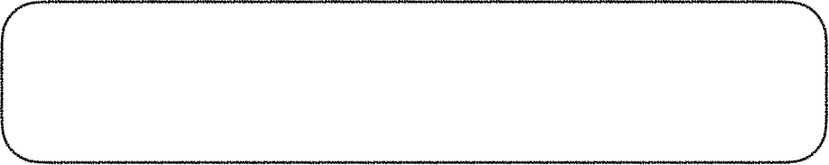
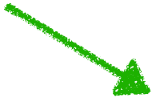



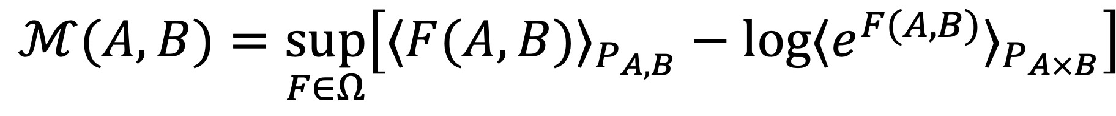
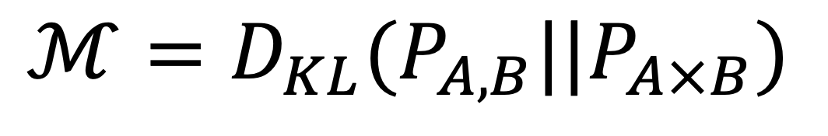
Mutual entropy as an optimization problem
Donsker & Varadhan (1983)
$$ℳ(A,B)=\sup_{F∈Ω}\left[⟨F(A,B)⟩_{P_{A,B}}−log⟨e^{F(A,B)}⟩_{P_{A×B}}\right]$$
Joint distribution
Product distribution
A
B
$$ℳ=D_{KL}(P_{A,B}||P_{A×B})$$
The probability of the two halves occurring simultaneously
The product of the probabilities of each half

Slide 7



Mutual entropy as an optimization problem
Donsker & Varadhan (1983)
$$ℳ(A,B)=\sup_{F∈Ω}\left[⟨F(A,B)⟩_{P_{A,B}}−log⟨e^{F(A,B)}⟩_{P_{A×B}}\right]$$
Belghazi et. al. JMLR 2018
MINE: Mutual information Neural Estimation
To estimate M, represent F as a neural network and optimize.
Joint distribution
Product distribution
Nir, Sela, Beck-Barkai, YBS, PNAS 2020
MICE: Machine-learning iterative calculation of entropy
Calculate the entropy of physical systems with iterative application of MINE
The probability of the two halves occurring simultaneously
The product of the probabilities of each half
Amit Nir
Eran Sela
Roy Beck-Barkai

Slide 8
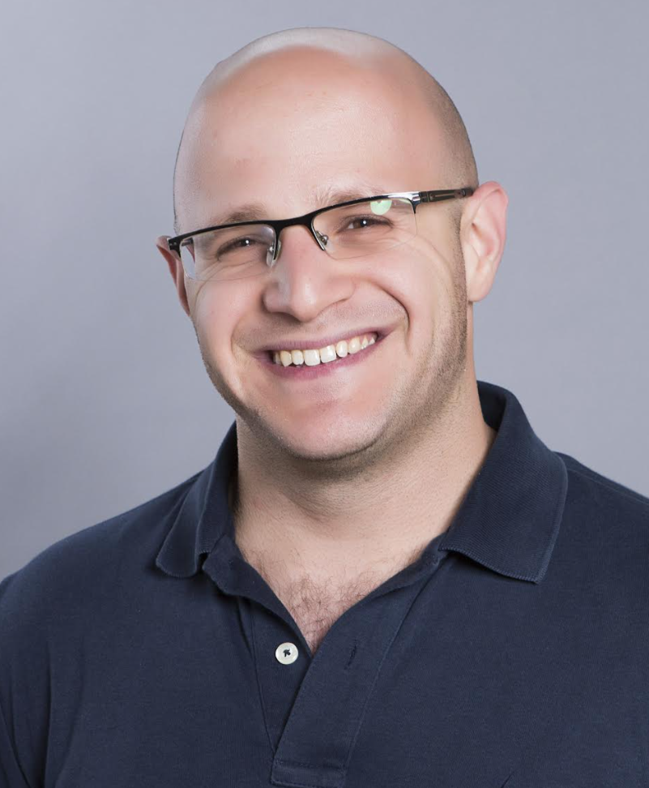


The challenge: estimate the melting temperature of metals
Liquid
The Plan
Barak Hirshberg
Run cheap MD simulations of each phase separately at a few temperatures
Use MICE to estimate the entropy of each phase
Combine with enthalpy (easily calculated) to compute Free Energy
Determine the melting temperature by F=0
Benchmark: WT-Metadynamics (Piaggi, Valsson, Parrinello, PRL 2017)
Solid
Yamin Ben-Shimon

Slide 9

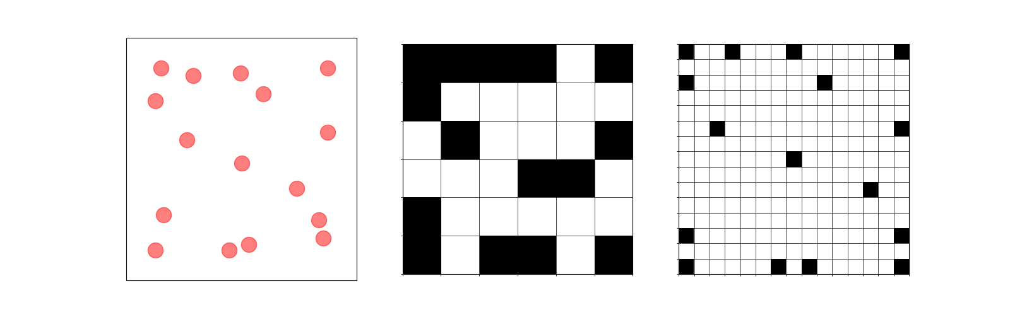
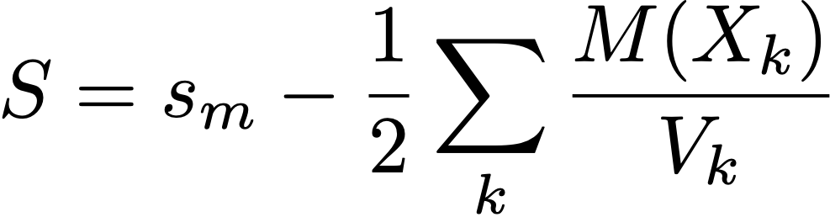
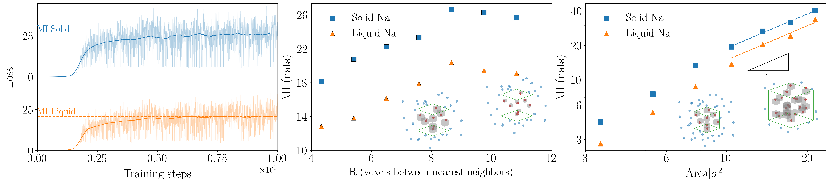
Interesting implementation details
How to represent a conformation?
Summing up MI to get entropy
Area law
In the works: more sophisticated representations (graphs)
MI vs resolution
# of voxels / lattice spacing

Slide 10
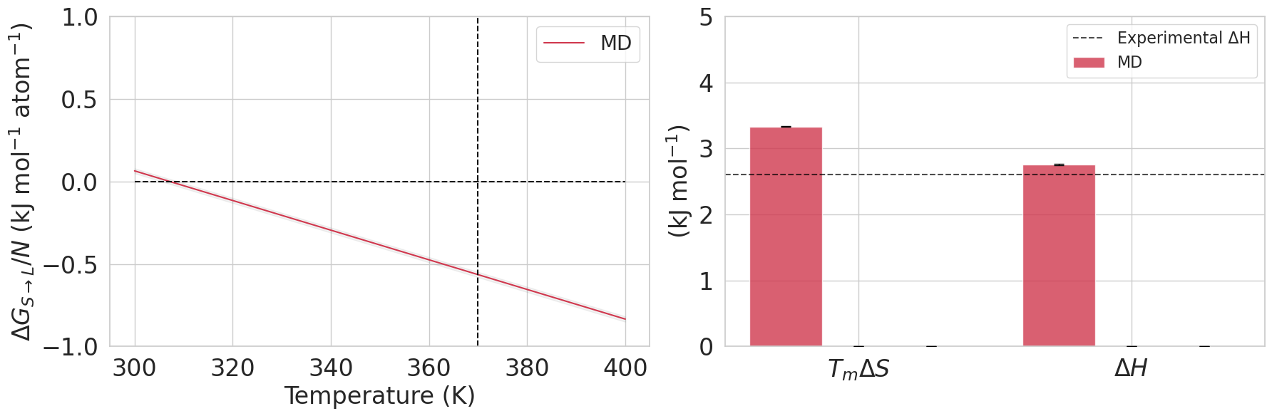
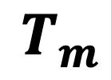
Results: Melting point of Sodium
$$T_{m}$$
Notes:
In standard MD we run two separate simulations
In red
In Blue,
The dashed line correspond
At the melting temperature both should equal each other and align with the dashed line, for which dG=0 This might seem like a small error, but the implications on the melting temperature are grave.
The reason we didn’t get the right answer

Slide 11
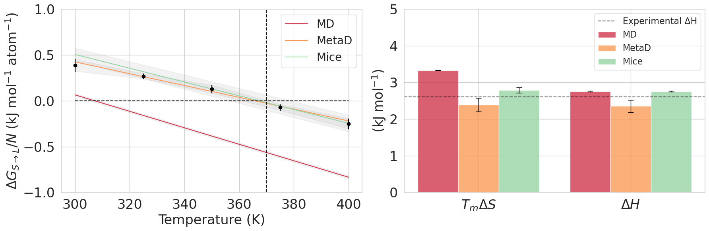
Results: Melting point of Sodium
$$T_{m}$$
Notes:
Again in metaD we choose Cvs, we add periodic bias , integrate over each phase at different temperature
I would like to remind that the reason for the

Slide 12
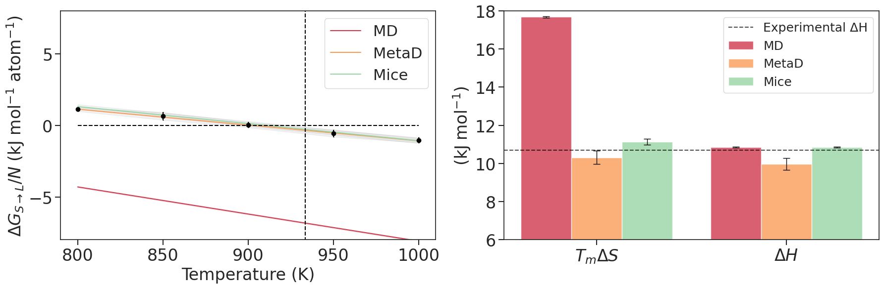
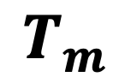
Results: Melting point of Aluminum
(no further tuning)
$$T_{m}$$

Slide 13


Summary and Take Home message
Estimating free energies of metastable states without transitions - only separate runs for each phase.
Runtime: MICE ~ hours, WT-MetaD ~ days
No good guess of a collective variable needed.
Decomposes Entropy to contributions from different scales.
Could be vastly improved (go to Yamin's poster!)
Barak Hirshberg
Yamin Ben-Shimon

